Slide 1
MAMCHINE LEARNING: PROBABILISTIC

Slide 2
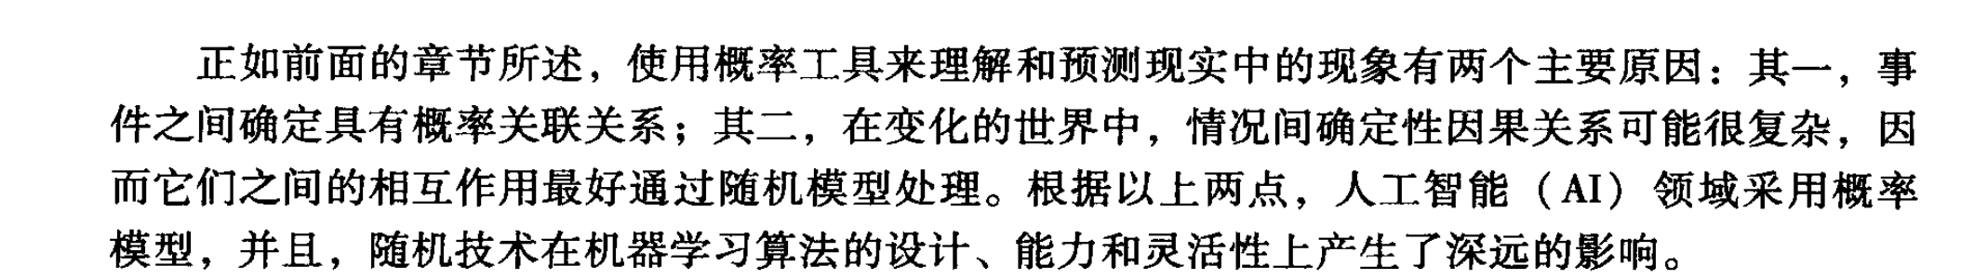
13.0 Stochastic and Dynamic Model of Learning
As noted in earlier chapters, there are two primary reasons for using probabilistic tools to understand and predict phenomena in the world: first, events may be genuinely probabilistically related to each other, and second, deterministic causal relationships between situations in the changing world may be so complex that their interactions are best captured by stochastic models.

Slide 3
13.1 Hidden Markov Models (HMMS)
In the early twentieth century the Russian mathematician Andrey Markov proposed a mathematics for modeling probabilistically related discrete stepped events.
概率相关的离散事件进行建模的数学方法。

Slide 4
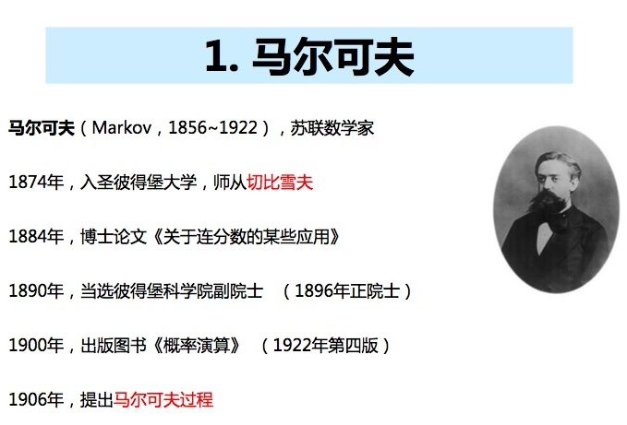
13.1 Hidden Markov Models (HMMS)

Slide 5
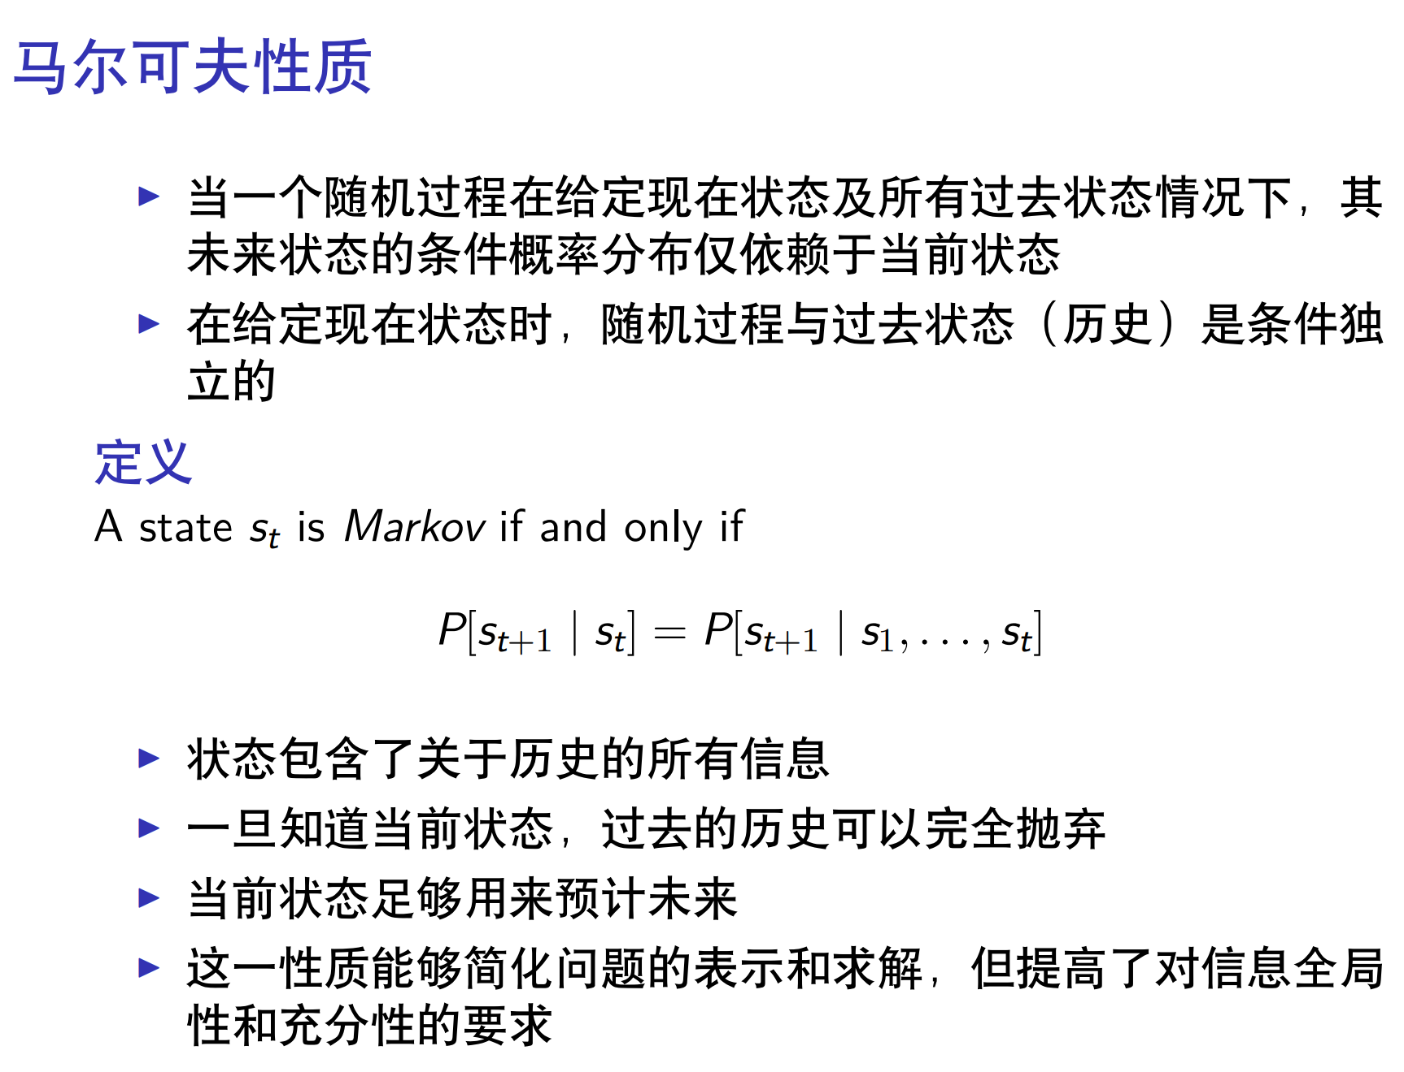
13.1.1 Introduction to and Definition of Hidden Markov Models

Slide 6
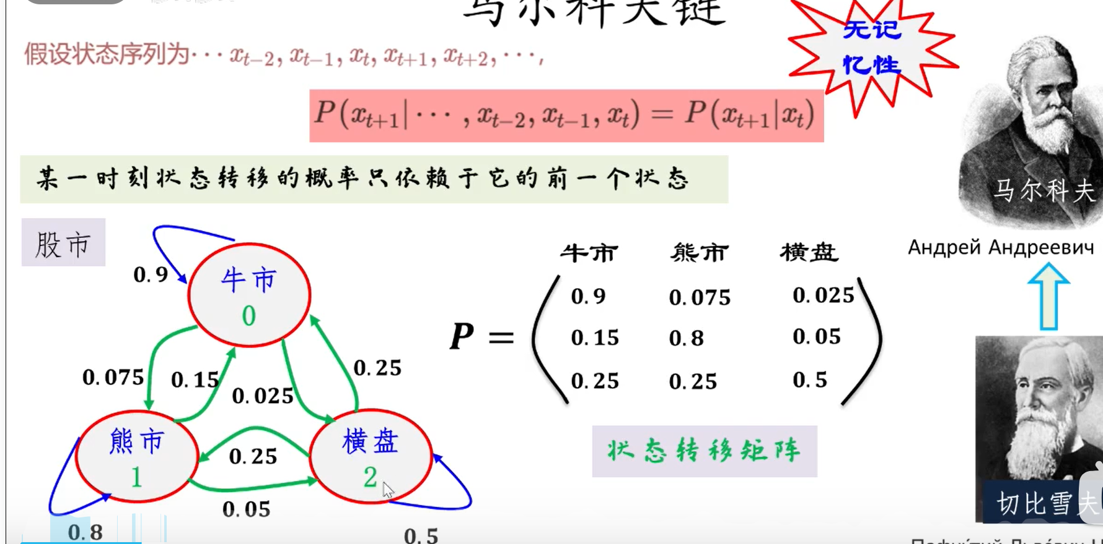
13.1.1 Introduction to and Definition of Hidden Markov Models

Slide 7

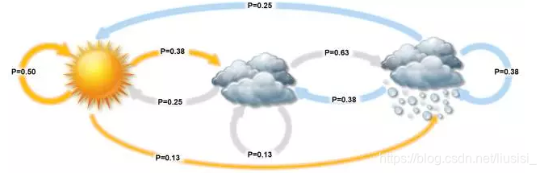
13.1.1 Introduction to and Definition of Hidden Markov Models
Notes:
在某段时间内，交通信号灯的颜色变化序列是：红色 - 黄色 - 绿色 - 红色。像交通信号灯一样，某一个状态只由前一个状态决定，这就是一个一阶马尔可夫模型。而像天气这样，天气状态间的转移仅依赖于前 n 天天气的状态，即状态间的转移仅依赖于前 n 个状态的过程。这个过程就称为n 阶马尔科夫模型。

Slide 8
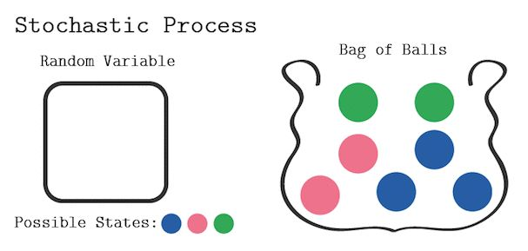
13.1.1 Introduction to and Definition of Hidden Markov Models
不放回的袋中取球?
有放回的袋中取球?

Slide 9
13.1.1 Introduction to and Definition of Hidden Markov Models
观察数据是当前隐藏状态本身的概率函数。
In this section we extend the Markov model to situations where observations are themselves probabilistic functions of current hidden states. Thus, the resulting model, called a hidden Markov model, is a doubly embedded stochastic process.
An HMM may be described as an observable stochastic process supported by a further non-observable, or hidden, stochastic process.
对于盲人来说也许不能够直接获取到天气的观察情况，但是他可以通过触摸树叶通过树叶的干燥程度判断天气的状态。于是天气就是一个隐藏的状态，树叶的干燥程度是一个可观察的状态，于是我们就有了两组状态，一个是不可观察、隐藏的状态（天气），一个是可观察的状态（树叶），我们希望设计一种算法，在不能够直接观察天气的情况下，通过树叶和马尔可夫假设来预测天气。
双重嵌入的随机过程。
由一个不可观测的、隐含的随机过程支持的可观测随机过程。

Slide 10
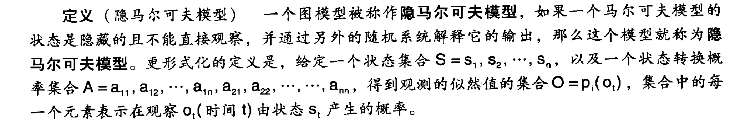
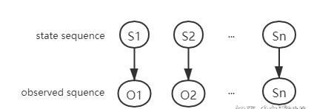
D E F I N I T I O N
HIDDEN MARKOV MODEL
A graphical model is called a hidden Markov model (HMM) if it is a Markov model whose states are not directly observable but are hidden by a further stochastic system interpreting their output. More formally, given a set of states S=s1, s2,…, sn, and given a set of state transition probabilities A=a11, a12,…,a1n, a21, a22,…,…, ann, there is a set of observation likelihoods, O=pi(ot), each expressing the probability of an observation ot (at time t) being generated by a state st.

Slide 11
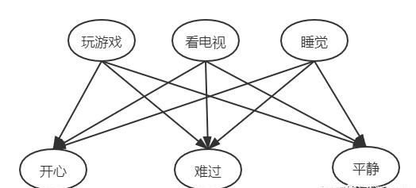
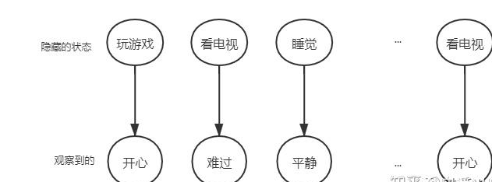

Slide 12
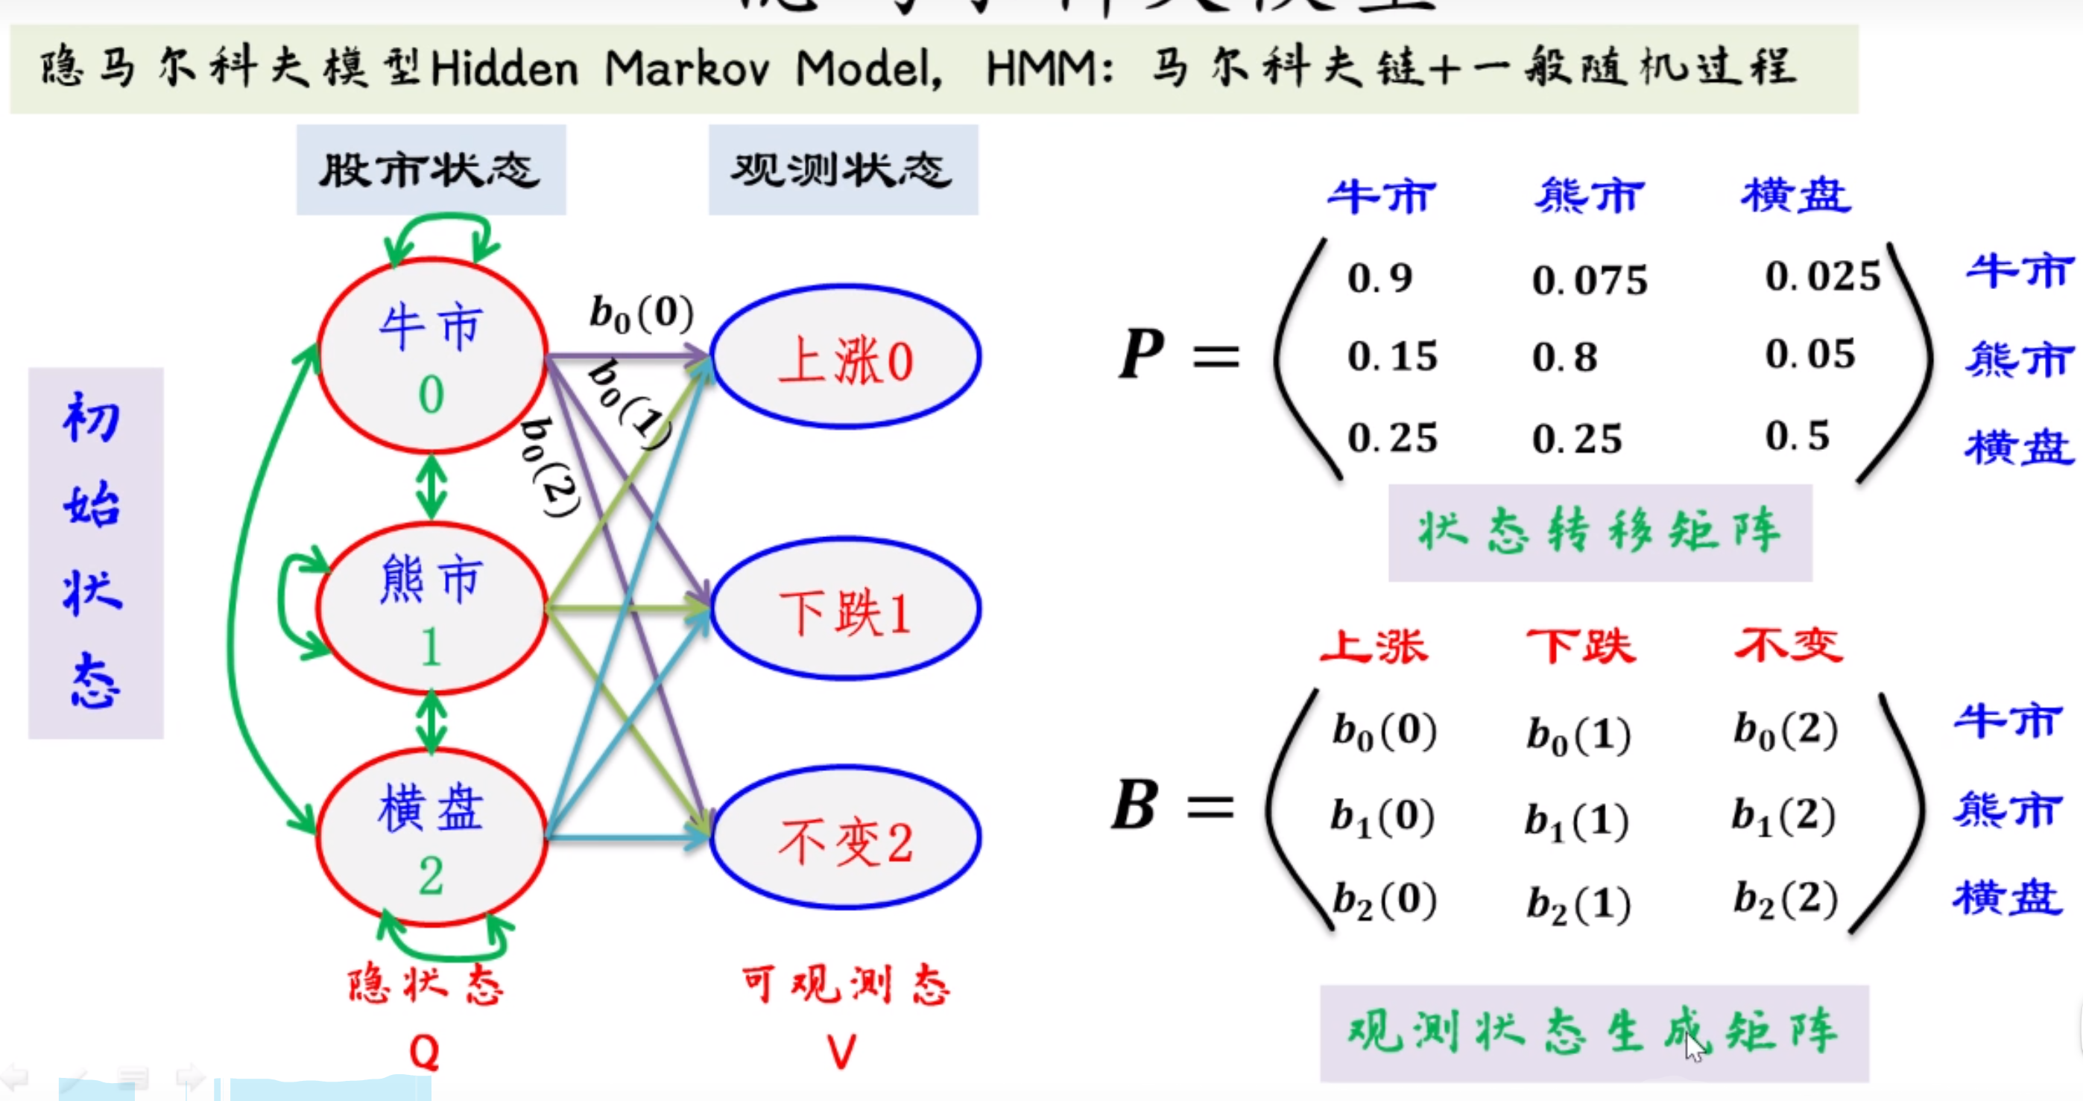

Slide 13
Given this situation, we now attempt to model the resulting set of observations emanating from the room. We begin with a simple model; suppose there is but one coin being flipped.

Slide 14
We next consider a two coin model, with two hidden states s1 and s2, as seen in Figure 13.1.
其中，H代表head，正面；T代表tail。
a12=1-a11
S1
S2
a22
a11
a21=1-a22
p(H)=b1
p(H)=b2
p(T)=1-b1
p(T)=1-b1

Slide 15
A third model is presented in Figure 13.2, where three states (three coins) are used to capture the coin flip output.
The difficult issue for the coin flipping problem is the choice of an optimal model.
The three state model of Figure 13.2 has nine parameters.

Slide 16
a22
p(H)=b2
p(H)=b2
S22
a32
a12
a21
a23
p(H)=b1
p(T)=1-b1
p(H)=b2
p(T)=1-b3
S22
a13
a11
S3
a33
a31
Figure 13.2 The state transition diagram for a three state hidden Markov model of coin flipping. Each coin/state, Si, has its bias, bi.

Slide 17

For a second example, consider the problem of N urns, each urn containing a collection of M differently colored balls.

Slide 18
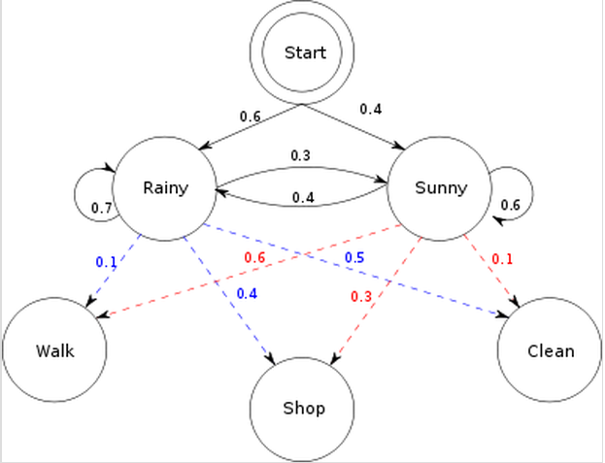

Slide 19
13.1.2 Important Variants of Hidden Markov Models
A widely used extension to HMMsz is called the auto-regressive HMM where a previous observation can also influence the value of the current observation. This extension is used to capture more information from the past and factor it into the interpretation of the present state.
One extension of HMMs, hierarchical HMMs or (HMMs), assumes that each state of a system is itself an HMM.
隐马尔可夫模型一阶特性中，当前状态只依赖于前一个状态，并且已经观测到的变量是无关联的。自回归隐马尔可夫模型从过去获得更多的信息，并且把这些信息引入到当前状态的解释中。

Slide 20
Auto-regressive HMMs (AR-HMMs)
auto-regressive hidden Marov model whose emission model is defined by the non-zero probability model:
p(Ot | St, Ot-1).
where O is the emit or observation state and S represents the hidden layer, as seen in Figure 13.3a.

Slide 21
Ot
Ot-1
存在链接
1.0
St-1
St
safe
faulty
p(S|O)
unsafe
0.5
Ot-1
Ot
0.0
a)
00
0
0m
b)
Figure 13.3 a. The hidden, S, and observable, O, states of the AR-HMM where p(Ot | St, Ot-1).
b. The values of the hidden St of the example AR-HMM: safe, unsafe, and faulty.

Slide 22
Figure 13.4 represents a sample of the data that is observed from the running system.
Figure 13.5 shows the results of processing the data of Figure 13.4 using a fast Fourier transform (FFT), to produce equivalent data on the frequency domain.
The three states of the hidden node, St, in Figure 13.3, are safe, unsafe, and faulty.

Slide 23
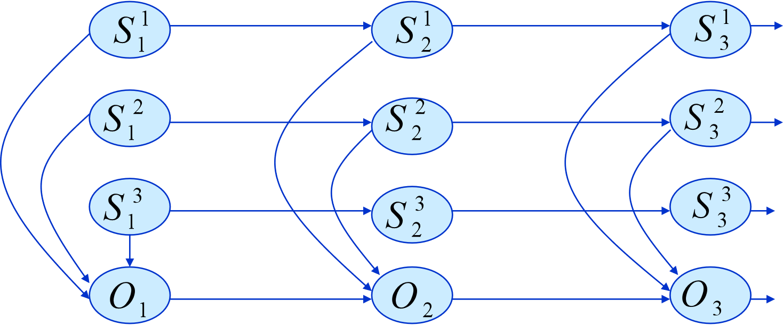
自回归隐马尔可夫模型能够通过观测到的序列得到状态空间的线索，并且尝试使用从观测到的系统产生数据序列信息来推测基本的隐藏状态。但是如果潜在过程是由几个子过程结合而成，将会发生什么？
Factorial HMMs
Figure 13.6 shows an auto-regressive factorial HMM.
This relation to the observable random variable can be defined by the CPD:

Slide 24
Hierarchical HMMs (HHMMs)
Hierarchical HMMs are used to model extremely complex systems.
In the hirarchical hidden Markov model (or HHMM) each individual state is considered a self contained probabilistic model.
极其复杂的系统建模。
自包含概率模型。

Slide 25
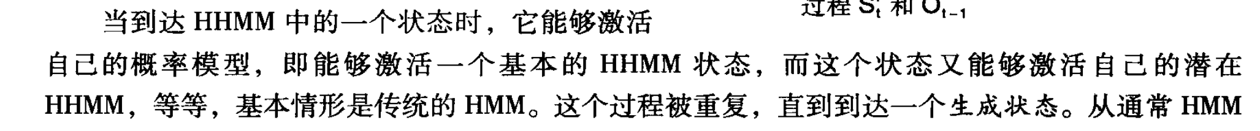
When a state in an HHMM is reached, it will activate its own probabilistic model, i.e., it will activate one of the states of the underlying HHMM, which in turn may activate its underlying HHMM, and so on, the base case being the traditional HMM.

Slide 26
It should be noted that a vertical transition can result in more vertical transitions before reaching a sequence of production states and finally returning to the top level. Thus the production states visited give rise to a sequence of observation symbols that are produced by the state at the top level.
N-Gram HMMs
With bi-gram Markov models the interpretation of the observable current state depends only on interpretation of the previous state, as p(Ot|Ot-1); this is equivalent to the traditional first-order Markov chain.

Slide 27
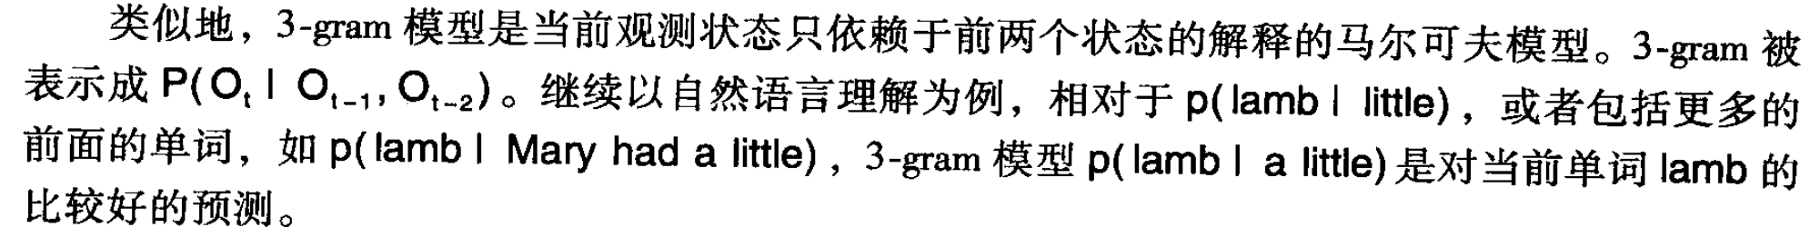
Similarly, tri-gram models are Markov models in which the interpretation of the observable current state depends on the previous two states. The tri-gram model is represented by P(Ot|Ot-1,Ot-2).
We can extend the n-gram Markov model to any length n that we feel captures the invariances(不变性) present in the data we are trying to model. An n-gram Markov model is a Markov chain in which the probability of the current state depends on exactly the n-1 previous states.

Slide 28
13.1.3 Using HMMs and Viterbi to Decode Strings of Phonemes
When dynamic programming is used to find the maximum probability of an a posteriori string, it is often called the Viterbi algorithm.
The following example of computational analysis of human speech patterns and the use of the Viterbi algorithm to interpret strings of phonemes is adapted from Jurafsky and Martin. We assume unambiguous interpretation of signals to simplify our presentation of the Viterbi algorithm processing of the HMM.
动态规划算法找到后验字符串的最大概率

Slide 29
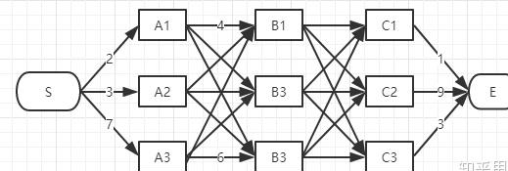
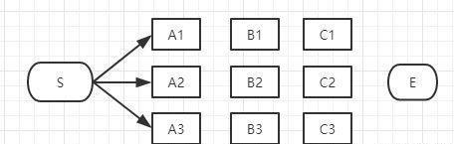
13.1.3 Using HMMs and Viterbi to Decode Strings of Phonemes

Slide 30
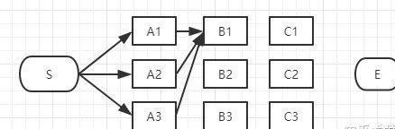
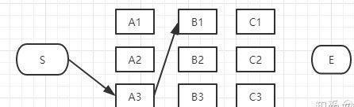
13.1.3 Using HMMs and Viterbi to Decode Strings of Phonemes

Slide 31
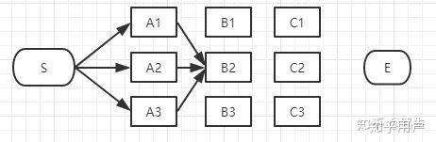
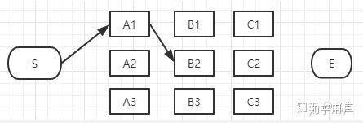
13.1.3 Using HMMs and Viterbi to Decode Strings of Phonemes

Slide 32
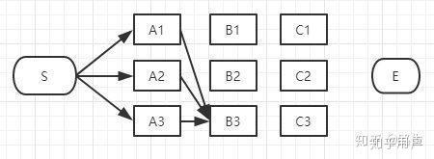
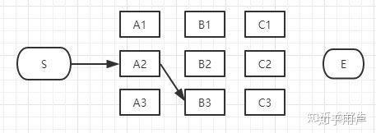
13.1.3 Using HMMs and Viterbi to Decode Strings of Phonemes

Slide 33
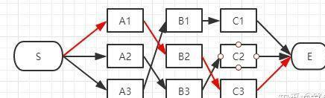
13.1.3 Using HMMs and Viterbi to Decode Strings of Phonemes
Viterbi算法：使用前向模式的Viterbi重复地找到下一个最佳的状态和值，并且设置一个指针。在后向模式中，回溯这些指针以获得最有的路径。这样，Viterbi的输出是一个状态的优化路径，在这条路径上含有该路径的概率。

Slide 34
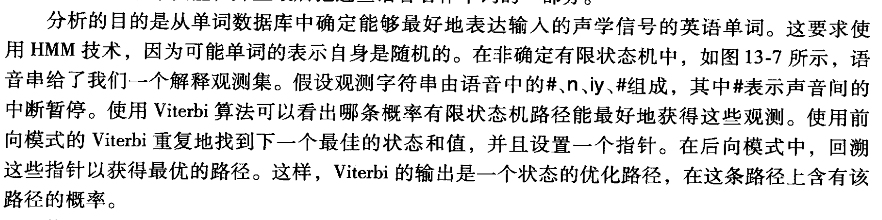
Figure 13.7 presents a segment of a database of words, related by the closeness of the sets of phonemes that make up their acoustic components.

Slide 35
neat
.00013
.48
n
iy
t
need
.00056
.52
n
iy
.89
d
.11
Start
#
End
#
.36
iy
n
new
.001
.64
um
knee
.000024
n
iy
Figure 13.7 A PFSM representing a set of phonetically related English words. The probability of each word occurring is below that word. Adapted from Jurasky and Martin (2008).

Slide 36
The goal of the analysis is to determine which English word from our database of words best represents the input of an acoustic signal. This requires use of the HMM technology, because the representation of possible words is itself stochastic.
使用Viterbi算法从单词数据库种确定能够最好地表达输入的声学信号的英语单词。

Slide 37
Using Viterbi, each state of the search is associated with a value. The value for being in state si at time t is viterbi[si,t]. The value associated with the next state sj in the state machine at time t+1 is viterbi[sj,t+1].
We next present pseudocode for the Viterbi algorithm.

Slide 38
function Viterbi (Observations of length T, Probabilistic FSM)
begin
number := number of states in FSM
create probability matrix viterbi[R=N+2,C=T+2];
Viterbi[0,0]:=1.0;
for each time step (observation) t from 0 to T do
for each state si from i=0 to number do
for each transition from si to sj in the Probabilistic FSM do
begin
new-count:=viterbi[si,t]* path[si,sj] * p(sj|si);

Slide 39
if ((viterbi[sj,t+1]=0) or (new-count>viterbi[sj,t+1]))
then
begin
viterbi[si,t+1]:=new-count
append back-pointer [sj,t+1] to back-pointer list
end;
end;
return viterbi[R,C];
return back-pointer list
end.

Slide 40
Start=1.0 | # | n | iy | # | end
neat .00013 2 paths | 1.0 | 1.0x .00013 =.00013 | .00013x1.0 =.00013 | .00013x .52 =.000067 (2 paths)
need .00056 2 paths | 1.0 | 1.0x .00056 =.00056 | .00056x 1.0 =.00056 | .00056x.11 =.000062 (2 paths)
new .001 2 paths | 1.0 | 1.0x .001 =.001 | .001x .36 =.00036 (2 paths) | .00036x1.0 =.00036
knee .000024 1 path | 1.0 | 1.0x .000024 =.000024 | .000024x1.0 =.000024 | .000024x1.0 =.000024
Total best |  |  |  |  | .00036
Figure 13.8 A trace of the Viterbi algorithm on several of the paths of Figure 13.7. Rows report the maximum value for Viterbi on each word for each input value (top row). Adapted from Jurafsky and Martin (2008).

Slide 41
13.2 Dynamic Bayesian Networks and Learning
In Section 13.2 we describe two different approaches to learning, structure learning and parameter learning, in the context of graphical models.
In Section 13.3 we explain how Markov models can be used for decision support by introducing the Markov decision process (or MDP) and the partially observed MDP ( or POMDP).

Slide 42
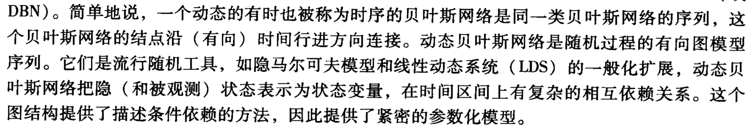
13.2.1 Dynamic Bayesian Networks
Briefly, a dynamic, sometimes called temporal, Bayesian network is a sequence of identical Bayesian networks whose nodes are linked in the (directed) dimension of time.
The individual BNs that make up the DBNs are not dynamic in the sense that they themselves do not change with time, the stationarity assumption, but they still support the modeling of dynamic processes.

Slide 43
At each time period (slice), a DBN is akin to a static BBN that has a set Qt, of Nh random variables representing the hidden states and a set Ot of No random variables representing the states that are observable.
The notation (1:N) means for all variables 1 through N:
where Zt(i) is the ith node in time slice t, Pa(Zt(i)) are the parents of Zt(i) and N=Nh+ No.

Slide 44
We show two time slices of a simple DBN in Figure 13.9.
Figure 13.9 A DBN example of two time slice. The set Q of random
variables are hidden, the set O observed, t indicates time.

Slide 45
13.2.2 Learning Bayesian Networks
Learning can be viewed as a combination of data compression of data compression, indexing, and storage for efficient recovery.
Structure Learning and Search
Structure learning addresses the general problem of determining the existence of statistical dependencies among variables.

Slide 46
In designing a probabilistic graphical model, every variable could be dependent on every other variable, while preserving the constraint that the resulting network is a directed acyclic graph.
Our work is to prune away as many (unnecessary) dependencies as possible from the fully connected graph.
Structure learning can be thought of as a problem of the search for the optimal structure in the space of all possible structures for a given set of variables representing some application domain.

Slide 47
This learned structure must describe both previously observed data and also fit new, possibly relevant, information.
Although searching the exponential space of possible directed acyclic graph structures by brute force methods is rather unrealistic for practical applications with many variables there are some principles that do help tackle this problem.

Slide 48
It is often difficult, however, to define a priori a measure of complexity for a structure.

Slide 49
Markov Chain Monte Carlo (MCMC)
Markov chain Monte Carlo (or MCMC) is a class of algorithms for sampling from probability distributions.
In the context of structure search we assume that the possible structures for a given set of variables from the state space of a Markov chain.
Over time, higher weights are used for transitions between closely related structures.

Slide 50
Each structure, when sampled, is associated with a score, typically a maximum a posteriori (or MAP) based score, the p(structure | data).
Parameter Learning and Expectation Maximization (EM)
Given an existing model of a problem domain, parameter learning attempts to infer the optimal joint distribution for a set of variables given a set of observations.

Slide 51
In many interesting applications of graphical models, however, there can be a problem of having an incomplete set of data for a variable. A further-and related-problem is the existence of possible hidden or latent variables within the model.
EM has proven to be one of the most popular methods of learning in statistical and probabilistic modeling.

Slide 52
Expectation Maximization for HMMs (Baum-Welch)
The Baum-Welch algorithm has two steps:
1. Calculate the forward and the backward probabilities for each temporal state;
2. On the basis of 1, determine the frequency of the transition- emission pair values and divide this by the probability of the entire sequence.

Slide 53
Step 1 of Baum-Welch uses the forward-backward algorithm.
Step 2 of the Baum-Welch algorithm is used to compute the probability of a particular output sequence, given the parameters of the model, in the context of hidden Markov or other temporal models.
A brute force procedure for solving the problem of HMM parameter learning is the generation of all possible sequences of observed events and hidden states with their probabilities using two transition matrices.

Slide 54
13.2.3 Expectation Maximization: An Example
Consider the Bayesian belief network of Figure 13.10, a BBN with 3 nodes, alarm A, burglary B, and earthquake Q.
This model, with some assumed probability measures, can be described in loopy logic by the program:
At|Bt, Qt=[[[.999,.001],[.7,.3]],[[.8,.2],[.1,.9]]]
We have simplified the actual loopy logic syntax to make the presentation clearer.

Slide 55
Bt
Qt
At
Figure 13.10 A Bayesian belief net for the burglar alarm,
earthquake, burglary example.

Slide 56
A Markov random field, or Markov network, is a probabilistic graphical model (see Section 9.3) whose structure is an undirected graph (as compared to the directed graphical models of Bayesian belief networks). The nodes of the structure graph of the Markov random field correspond to random variables and the links between the nodes correspond to the dependencies between the connected random variables.

Slide 57
The quantitative components of the Markov random field are specified by a set of potential functions, whose domain is a clique of the graph structure of the Markov random field, and that define a correspondence between the set of all possible joint assignments to the variables from the clique and the set of nonnegative real numbers.
In the loopy logic system, a special version of a Markov random field is used. A potential function is assigned to each dependency between random variables.

Slide 58
Figure 13.11 illustrates the bipartite Markov random field that captures the potential functions of the BBN of Figure 13.10.
t
f
B1
Q1
=[[[.999,.001],[.7,.3]],[[.8,.2],[.1,.9]]]
A1
Figure 13.11 A Markov random field reflecting the potential functions of the random variables in the BBN of Figure 13.10, together with the two observations about the system.

Slide 59
In loopy logic we can specify facts about the model and ask queries; for instance, we can state:
B1=t.
Q1=f.
A1=?
An interpretation of these three statements is that we know that at time 1 there was a burglary, that there was no earthquake, and that we would like to know the probability of the alarm going off.

Slide 60
In addition, loopy logic supports learning by allowing its users to assign learnable distributions to selected rules of a loopy logic program. To denote this we use the variable L in the program:
At | Bt, Qt=L
We can now present a collected set of observations to the loopy logic interpreter over a set of time periods using the fact representation, below. For simplicity, we collect only three data points at each of three time intervals:

Slide 61
Q1=f
B1=t
A1=t
Q2=t
B2=f
A2=t
Q3=f
B3=f
A3=f
For the alarm BBN shown in Figure 13.10, its corresponding Markov random field, with the learnable parameter L linked to each cluster node whose rule unifies with the learnable rule presented earlier (At | Bt,Qt=L), is presented in Figure 13.12.

Slide 62
We next populate the known distributions of the BBN, and make a random initialization to the cluster nodes R1,R2, and R3 as well as to the learnable node L. Figure 13.12 shows the result.

Slide 63
E.1
E.2
L
M
t
f
f
t
f
f
B1
Q1
B2
Q2
B3
Q3
R1
R2
R3
A1
A2
A3
t
t
f
Figure 13.12 A learnable node L is added to the Markov random field of Figure 13.11. The Markov random field iterates across three time periods. For simplicity, the EM iteration is only indicated at time 1.

Slide 64
The expectation maximization algorithm is an iterative process implemented through message passing.
By doing inference (loopy belief propagation) on the cluster and variable nodes, we compute the message for the learnable nodes.
Applying this belief propagation algorithm until convergence yields an approximation of the expected values.

Slide 65
To summarize the algorithm, and as displayed in Figure 13.12:
In the expectation or E step:
1. All cluster nodes send their messages to the variable nodes.
2. All variable nodes send their messages back to the cluster nodes updating the information of the cluster nodes.
In the maximization or M step:
1. The cluster nodes send messages, updated in the E step. To learnable nodes where they are averaged.

Slide 66
13.3 Stochastic Extensions to Reinforcement Learning
To illustrate the concepts of reinforcement learning, we consider the example of a recycling robot. The agent must make one of three decisions:
1.The robot can actively search for a soda can during a certain time interval;
2.The robot can pause and wait for someone to bring it a soda;
3.The robot can return to the home base to recharge its batteries.

Slide 67
The robot makes decisions either in some fixed time period, or when an empty can is found, or when some other event occurs. Consequently, the robot has three actions while its state is being determined.
There is a major limitation of the traditional reinforcement learning framework that we have just described: it is deterministic in nature.

Slide 68
13.3.1 The Markov Decision Process (or MDP)
In many actual reinforcement learning applications, this might be the situation: the agent does not have complete knowledge or control over the next state of the world. Specifically, taking an action from state st might lead to more than one possible resulting state at time t+1.
In all these situations, we need a more powerful framework for setting up the reinforcement learning problem. One such framework is the Markov decision process (or MDP).

Slide 69
We next define the MDP:
D E F I N I T I O N
A MARKOV DECISION PROCESS, or MDP
A Markov Decision Process is a tuple<S,A,P,R> where:
S is a set of states, and
A is a set of actions.
pa(st,st+1)=p(st+1 |st, at=a) is the probability that if the agent executes action a A from state st at time t, it results in state st+1 at time t+1. Since the probability, pa∈ P is defined over the entire state-space of actions, it is often represented with a transition matrix.
R(s) is the reward received by the agent when in state s.

Slide 70
13.3.2 The Partially Observable Markov Decision Process (POMDP)
D E F I N I T I O N
A PARTIALLY OBSERVABLE MARKOV DECISION PROCESS, or POMDP
A Partially Observable Markov Decision Process is a tuple<S,A,O,P,R> where:
S is a set of states, and
A is a set of actions:
O is the set of observations denoting what the agent can see about its world.
Since the agent cannot directly observe its current state, the observations are probabilistically related to the underlying actual state of the world.

Slide 71
pa(st,o,st+1)=p(st+1,ot=o | st, at=a) is the probability that when the agent executes action a from state st at time t, it results in an observation o that leads to an underlying state st+1 at time t+1.
R(st,a,st+1) is the reward received by the agent when it executes action a in state st and transitions to state st+1.

Slide 72
To summarize, the MDP can be considered to be a special case of the POMDP, when the observation o gives us an accurate indication of the current state s.

Slide 73
13.3.3 An Example Implementation of the Markov Decision Process
To illustrate a simple MDP, we take up again the example of the recycling robot (adapted from Sutton and Barto 1998) introduced at the beginning of Section 13.3.
The state of the battery is determined independent of actions taken.
We next create a reward system: once the battery is run down, S=low, the robot is rescued, its battery is recharged to high, and it gets a reward of -3

Slide 74
st st+1 at Pa(St,St+1) Ra(St,St+1)
high high search a R_search high low search 1-a R_search low high search 1-b -3 low low search b R_search high high wait 1 R_wait high low wait 0 R_wait low high wait 0 R_wait low low wait 1 R_wait low high recharge 1 0 low low recharge 0 0
Table 13.1. Transition probabilities and expected rewards for the finite MDP of the recycling robot example. The table contains all possible combinations of the current state, st, next state, st+1, the actions and rewards possible from the current state at.

Slide 75
To represent the dynamics of this finite MDP we can use a graph, such as Figure 13.13, the transition graph of the MDP for the recycling robot. A transition graph has two types of nodes: state nodes and action nodes.

Slide 76
1,
wait
b,
1-b, -3
search
recharge
high
low
search
a,
a,
1,
Figure 13.13. The transition graph for the recycling robot. The state nodes are the large circles and the action nodes are the small black states.

